Slide 2
Infrastructure and Security for SQL DW
Ron Ortloff
Azure SQL DW
Sr. Program Manager
rortloff@microsoft.com
@RonOrtloff

Slide 3
Agenda
Azure Active Directory (AAD)
AAD configuration and lessons learned
Understanding ExpressRoute
Securing network access
Trust Center & compliance certifications

Slide 4
Azure Active Directory (AAD)

Slide 5
What is Azure Active Directory
Windows
Active Directory
Azure
Active Directory
Azure
SaaS
Public
cloud
Federation
On-premises
Azure Active Directory
Cloud

Slide 6




Secured Enterprise Environment
Report Writers
Power Users
Data Management
Azure Active Directory
SQL Data Warehouse

Slide 7



AAD Authentication Types
Azure Active Directory
Azure
SQL Data Warehouse
On premises Active Directory
AAD
ADFS
SSMS
Custom app

Slide 8
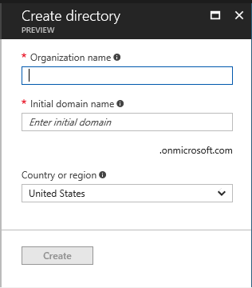
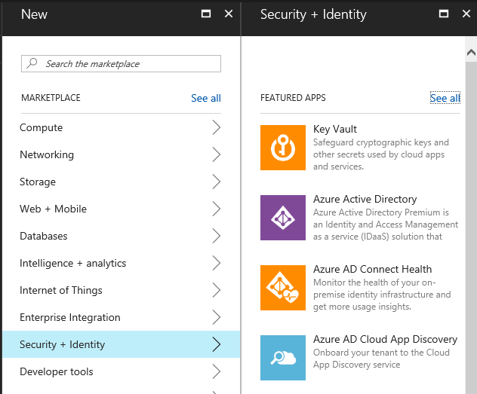
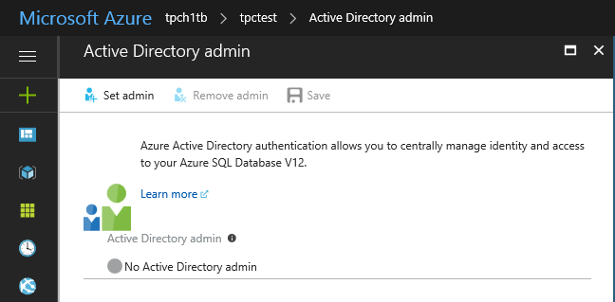
Setting up AAD
Associate on-premises AD with the Azure Subscription (as service admin via the portal)
OR
Create and populate Azure AD.
Configure an AAD admin for your SQL DW server
Create database users that leverage the FROM EXTERNAL PROVIDER syntax
CREATE USER [billg@microsoft.com] FROM EXTERNAL PROVIDER;
mydw > dwsrv>

Slide 9
AAD – Best Practices
Like the SQL DW Server Admin, the AAD Admin is placed in the SmallRC… users default to the smallest resource class.
When federating with on-premises accounts, they must be mail enabled.
Use the display name to grant access to Azure AD groups (not sequilggroup@contoso.com).
Be careful when granting access to AD groups, then elevating their resource class as it is much easier to hit concurrency limits... DBAs for CCI -> XLargeRC
AAD requires a good amount of reliable bandwidth for authentication.

Slide 10
ExpressRoute

Slide 11
What is ExpressRoute?
ExpressRoute provides a private, dedicated, high-throughput network connection between on-premises and Microsoft Azure
Predictable performance
Security
High throughput
Lower cost

Slide 12
Two flavors of ExpressRoute
Exchange Provider (IXP)
Network Service Provider (NSP)
Public
internet
Azure
Customer site 3
Azure
Customer site 2
WAN
Public
internet
Customer site
ExpressRoute
partner location
Customer site 1
Customer already using Exchange provider (co-location)
Meet Azure at Exchange Provider location for a simple point to point connection
Connect to Azure directly through a virtual cross connection
Higher flexibility, control over routing
Install, configure, & manage your hardware in the Exchange Provider’s datacenter
Customer already getting managed WAN services (like MPLS VPN) from Network Service Provider (e.g. Telco carrier)
Connect to Windows Azure through managed WAN provider leveraging existing network infrastructure
Easy onboarding
Use your existing managed WAN to connect to Azure
Access Azure from any site on the provider’s WAN
Suitable for

Slide 13
Exchange or Network Service Provider
 | Connectivity through Exchange providers (IXP) | Connectivity through network service providers (NSP)
Customer | Already in co-lo facilities Point-to-point connection | Already using NSP’s VPN services Multi-point connections (access from any site)
Supported bandwidth options | 200, 500Mbps, 1 or 10Gbps | 10, 50, 100, 500Mbps, 1Gbps
Pricing & data transfer | Throughput-based tiers; separate data charges | Throughput-based tiers with unlimited data transfer
Routing | Managed by ExpressRoute customer | Managed by NSP
High availability | Customer deploys two routers in the co-location | NSP provides redundant connectivity

Slide 14
ExpressRoute Pricing
Exchange Provider
Network Service Provider
Monthly fee with included data transfer (by zones)
Tiers with hard caps on bandwidth + unlimited data transfer
1Gbps Port + 15 TB included egress
10 Mbps
50 Mbps
100 Mbps
Per month:
$436
Free Ingress
Overage:
$0.025/GB Zone 1 $0.05/GB Zone 2
Per month:
$436
Per month:
$872
Per month:
$1,300
10Gbps Port + 90 TB included egress
500 Mbps
1 Gbps
Per month:
$5,000
Free Ingress
Overage:
$0.035/GB Zone 1 $0.07/GB Zone 2
Per month:
$5,200
Per month:
$8,700

Slide 15

Connectivity to Azure
Azure Public Services
Access all Azure Services
Connectivity provider
infrastructure
ExpressRoute Peering Site
Customer’s
dedicated
connection
Customer’s network
Azure Compute
Traffic to Azure Storage, SQL DW, …
Traffic to VNETS, IAAS VM’s

Slide 16


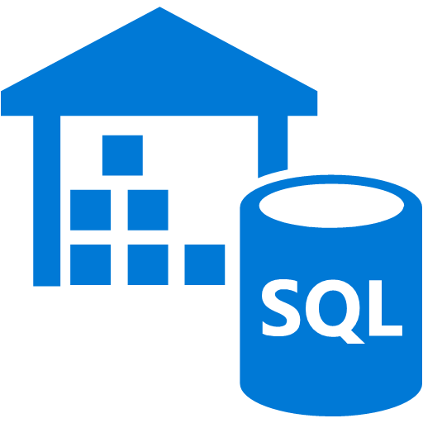


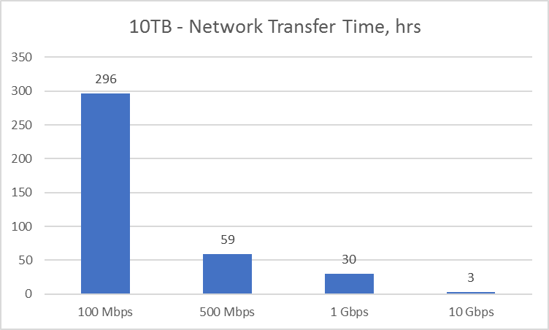

Tying it all together – balance the system
On-prem
Systems

Slide 17
Securing network access

Slide 18
Securing network access
Classic hybrid scenario: on-prem operational systems and data tiers in the cloud – Security department does not allow network traffic over the public internet.
Currently, multi-tenant services such as ADF, SQL DB and SQL DW cannot be added to a VNET. Routed through public channel of Express Route.
Options:
Leverage IP firewall rules.
Disable “Allow access to Azure services”

Slide 19
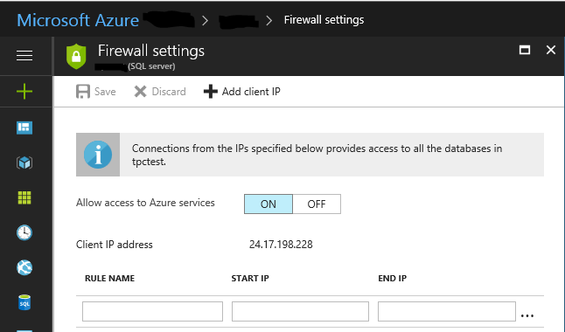
Allow access to Azure services
Turn off “Allow access to Azure services” (on by default)

Slide 20
Firewall Configuration
Apply DW firewall rules to limit the amount of public IPs that can access the DW instance
EXECUTE sp_set_firewall_rule @name = 'my FW setting',
@start_ip_address = '0.0.0.4',
@end_ip_address = '0.0.0.4'

Slide 21
VNET Service End-Points

Slide 22

Current State
VNET A
VNET A
VM
SQL DW secured to VNET A
SQL DW
Storage Account
Notes:
Current State
Scenario: SQL DW is secured to VNET A while Storage Account isn’t. You’re trying to load data from a VM in that VNET A.
This scenario works today.

Slide 23
Current State
VNET A
VNET A
VM
Storage Account secured to VNET A
SQL DW secured to VNET A
SQL DW
Notes:
Current State
Scenario: Both Storage Account and SQL DW are secured to the same VNET A and you’re trying to load data from a VM in that VNET A.
Even though SQL DW instance is secured to VNET A, it can’t connect to Storage Account that’s secured to the same VNET A. This is because, while SQL DW control node has access to storage account in this case, underlying compute nodes don’t have access to the storage account. Customers see “Msg 105019, level 16, state 1, line 28 External TABLE access failed due to internal error….This request is not authorized to perform this operation” error.
Workarounds suggested so far:
- Temporarily disassociate storage account from VNET and/or disable firewall rules
- Copy data into an unprotected storage account

Slide 24
Private Preview
VNET A
VNET A
Storage Account secured to VNET A
SQL DW secured to VNET A
Subscription ID
SQL DW
Notes:
Private Preview:
We whitelist customer’s DW instance(s) upon their consent. 1) With this, SQL DW would be able to access storage account as long as both of them are part of the same subscription. B) SQL DW needn’t be secured to a VNET for this to work. ** Customers should know that this is a temporary workaround until the main GA functionality is lit up.

Slide 25
Private Preview
VNET A
VNET A
Storage Account secured to VNET A
Subscription ID
SQL DW
Notes:
SQL DW needn’t be secured to a VNET for this to work. They need to belong to the same subscription (for private preview solution).

Slide 26
Private Preview
VNET A
VNET A
SQL DW
Storage Account secured to VNET A
SubscriptionID
Notes:
SQL DW access will *fail* if storage account is in a different subscription than SQL DW.

Slide 27
Private Preview
SQL DW secured to VNET A
VNET A
VNET A
SQL DW
Storage Account secured to VNET A
SubscriptionID
Notes:
Private Preview: SQL DW access will *fail* if storage account is in a different subscription than SQL DW regardless of whether it’s secured to the same VNET or not.

Slide 28
Compliance – Trust Center

Slide 29
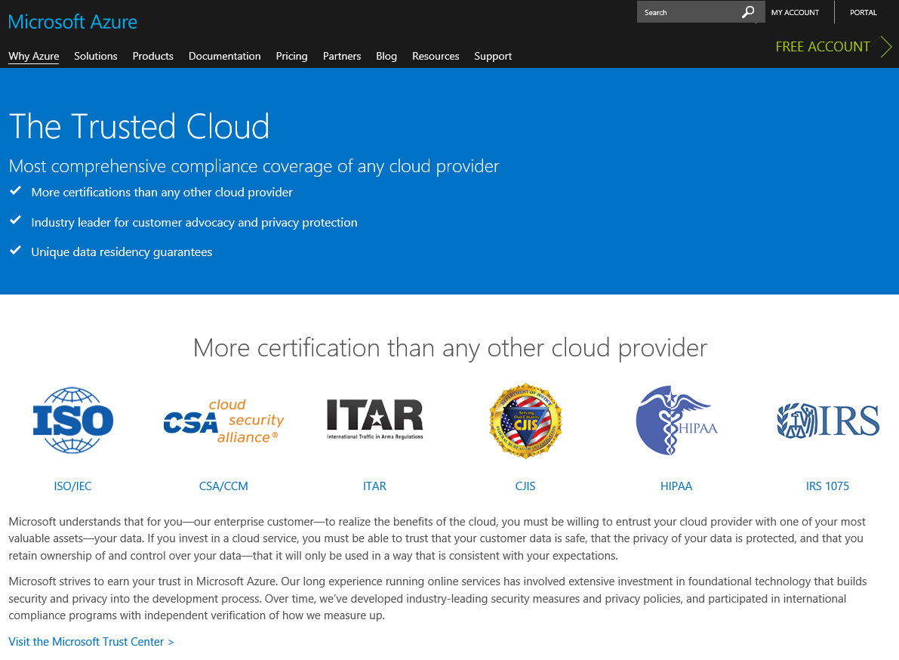
Trust Center
The Microsoft Azure Trust Center contains all relevant materials regarding compliance certifications
Supplier assessments, RFPs, etc., may also need documentation on how Azure Services are engineered. Visit the Security Development Lifecycle (SDL) site for further details.
Trust Center has resources on privacy as well as the online service terms

Slide 30





Compliance certifications

Slide 31
HIPAA compliant solutions
A Healthcare solution requiring HIPAA compliance can leverage SQL DW.
HIPAA Details on Trust Center are here:
HIPAA and the HITECH Act
As stated:
“Your organization is responsible for ensuring that you have an adequate compliance program and internal processes in place, and that your particular use of Microsoft services aligns with HIPAA and the HITECH Act.”
HIPAA BAA at:
Licensing Terms and Documentation

Slide 32
Portal access and control

Slide 33
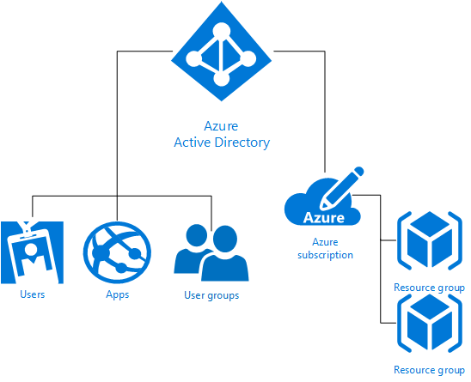
Portal access and control
2 ways to go:
Microsoft account: outlook.com, live.com, …
Organization account.
Azure RBAC has 3 basic roles (subscription, a resource group, or a single resource)
Owner
Contributor
Reader

Slide 34
Subscription and portal access template
Account Administrator
Service Administrator
Dev
Service Administrator
Service Administrator
Co-Admin
Co-Admin
…
Pre-Prod
Co-Admin
…
Co-Admin
Prod
Co-Admin
…
Co-Admin
Account admin provisions subscriptions
Service Admin has 1:1 mapping with subscription
Each type of environment can have up to 10 co-admins.
Benefits:
Control access per environment
Avoid accidental deployment and config changes
Monitor and control usage.

Slide 35
SQL DW - Portal access scenarios
Give access to a user to pause or scale an instance.
SQL DB contributor
Allow a client to view portal information on their DW instance
Microsoft.ResourceHealth/availabilityStatuses/read

Slide 36
Security

Slide 37

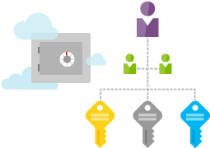








SQL DW Security
AAD &
Univ. Auth.
Auditing &
Threat Detection
CLS
TDE
Firewall
AKV for TDE
Supported
Not Supported
VNET
RLS
Always Encrypted
DDM

Slide 38
Column-Level Security
Fine-grained
Access Control
Centralized Security Logic
Simplification of E2E solution
Fine-grained access control over table columns
Access restriction logic resides in the database engine
No need to re-design data warehouse
Removes the need to introduce views
Removes the need to add logic into application tier
Implement using familiar T-SQL

Slide 39
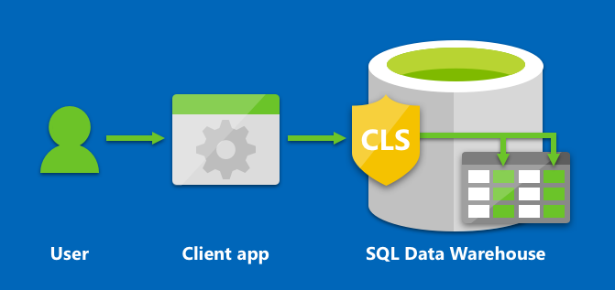
Column-Level Security
Scenarios
Financial firms allow only account managers to have access to customer SSN and other PII data.
Health care providers allow only doctors and nurses to have access to sensitive medical records.
Implementation
GRANT SELECT on dbo.Customers (CustomerId, FirstName, LastName) to ContractEmp

Slide 40
CLS Demo

Slide 41
Running SSMS without port 1433 opened
Local security and compliance teams may not allow opening of outgoing connections to port 1433 from on premises machines
There are two workarounds for SSMS:
Run SSMS in Remote Desktop Services
OTS solution, leverage out of the box.
Leverage a port-bridge solution.
Custom solution, with flexibility

Slide 42
…in summary

Slide 43
Best Practices
Address security concerns and sign-offs during POC phase.
Look for these “maturity markers” when interacting with Enterprise customers:
AAD Federation
ExpressRoute in place
Secured Network
Proper portal access

Slide 44
Q&A

